Slide 1
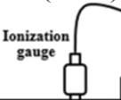
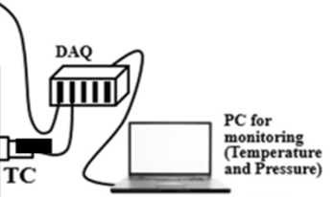
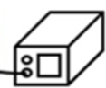
Ionization gauge
GS
PC for monitoring (Temperature and Pressure)
Shroud
BIRDS-5
P1
Power supply
P2
DP
RP
Coolant
Deployment switch

Slide 2
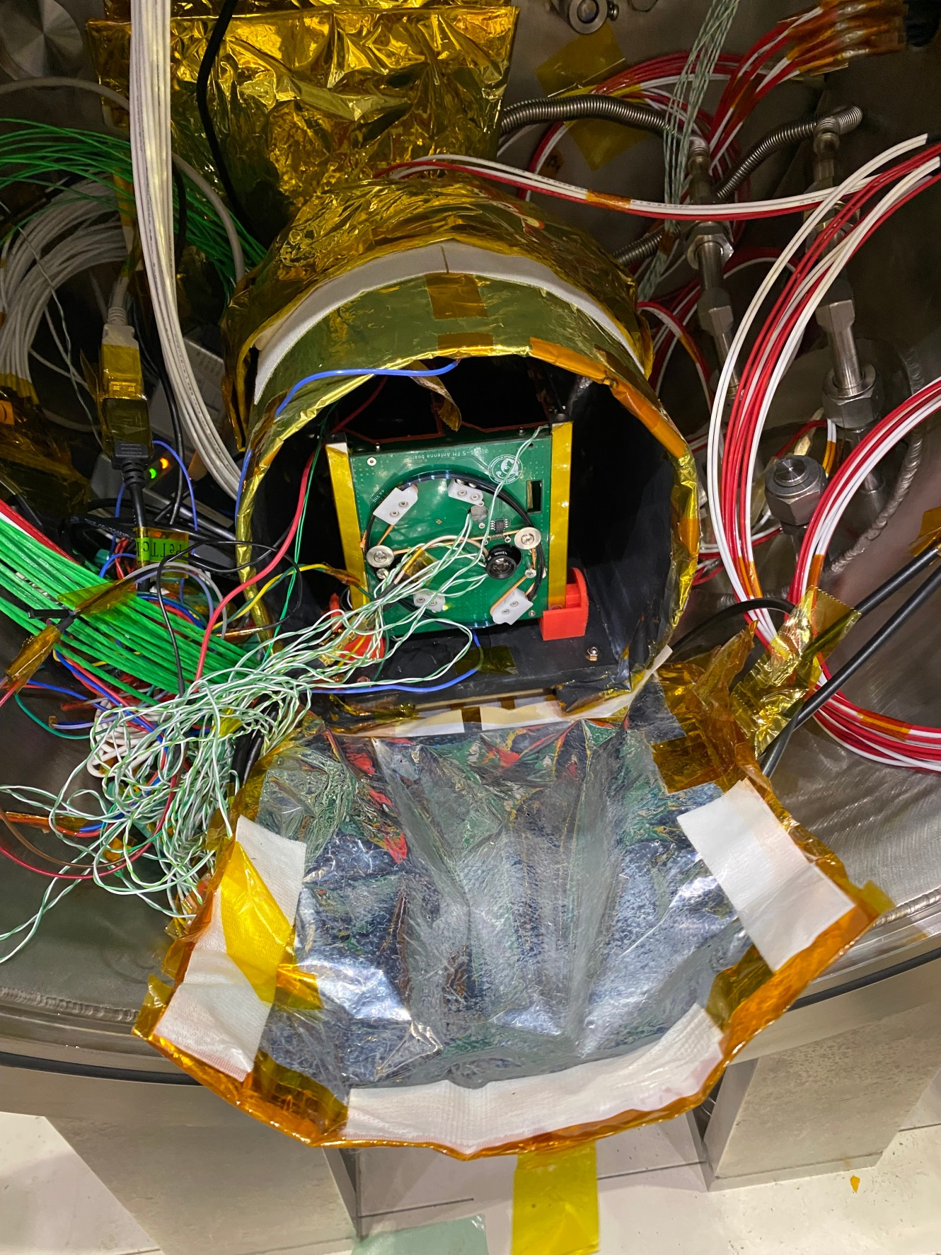
Satellite
Shroud
Support
Peltier device

Slide 3
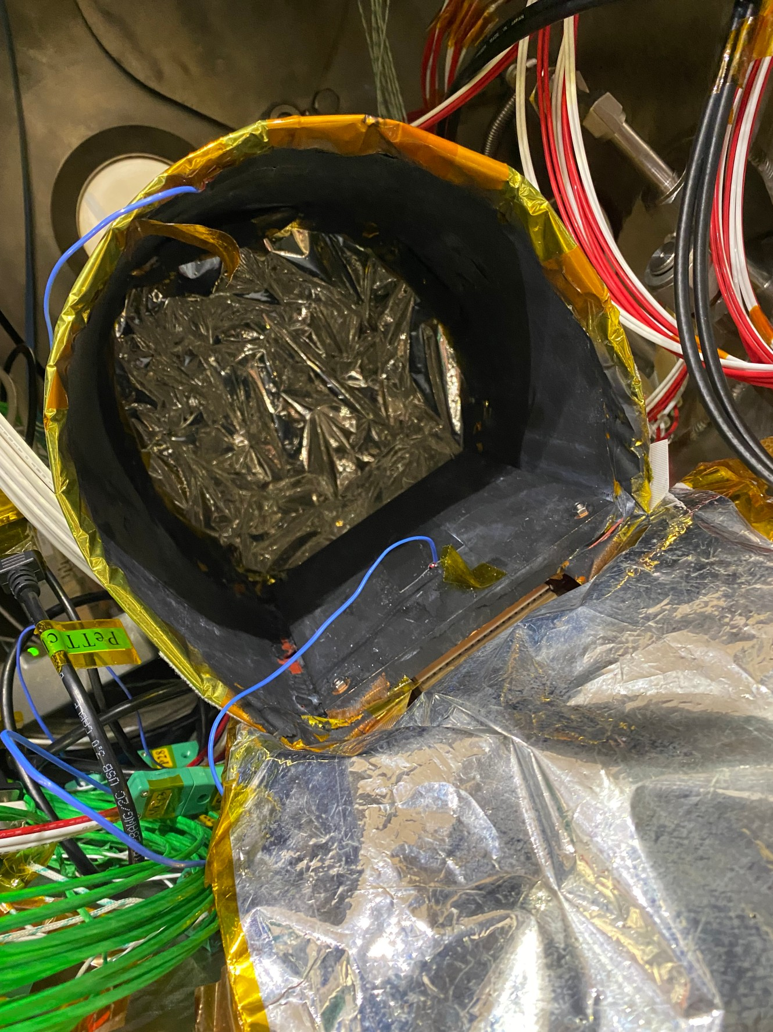
Bottom plate

